Slide 1
CHAT APPLICATION
Ben jeddou Fatma
Jadla Chames

Slide 2
Project Description :
The chatting application has huge impact on day to day life. There are numerous chatting application available in this world. Each application has different additional features varying from other applications.These application organizations compete with each other and add some competing features during each release. They have reached people much and have an impact on people's life. People find a better application from an available internet application which they feel much reliable and secure. Some of the available chatting applications that are available
in these days are Whatsapp, Facebook, Instagram, Hike, etc...The above mentioned applications have billion users
all over the world. Those companies are one of the top companies in the world . They have higher revenue per yearand have many employees for their organizations developing additional features to compete with other organizations during their each release. These applications have different features and follows different ways to ensure security of
their user data.

Slide 3
Technologies Used
In this project, we used the following technologies:
Frontend: HTML, CSS, React.JS
Backend: NodeJs, Express.Js, Socket.io
Database: MongoDB

Slide 4
FUTURE SCOPES
Especially if I don't have any experience. Finding work can be a real challenge. A successful learning can help me turn an experience into a career opportunity.
To be work IT company.
Can work as a Software Engineer.
Can work as a Web Designer.
Can work as a Web Developer.
Can work as a QA Tester.

Slide 5
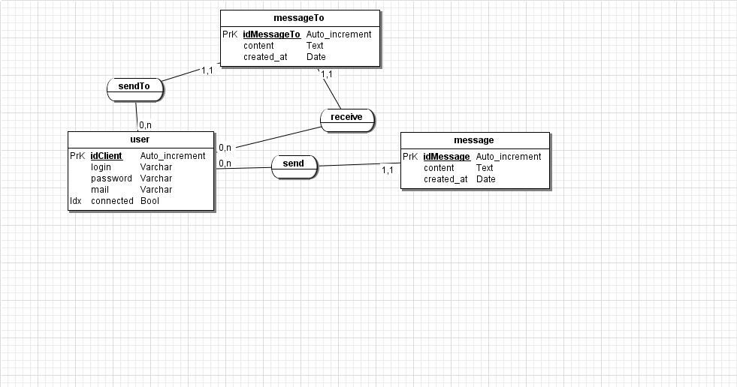
Class diagram

Slide 6
Conclusion
As a conclusion, I can say that this undergoing project is giving great experience. Thanks to this project, I am acquiring deeper knowledge concerning my technical skills but I also personally benefited. Currently MERN stack is a common technologies of web applications and chat applications, and one of the most popular technology for development used by developers worldwide. If we surf internet we can see millions of websites, applications and games built with MERN and MEAN stack. I am learning to live in a different environment from the one I am used to. Indeed, I am growing more independent in work and also in everyday life, realizing that I could do more things than I thought like learning new things by myself.

